Slide 1

Engaging the Customer throughout Product Development and Commercialization
Nancy Lonsinger
September 23, 2019

Slide 2
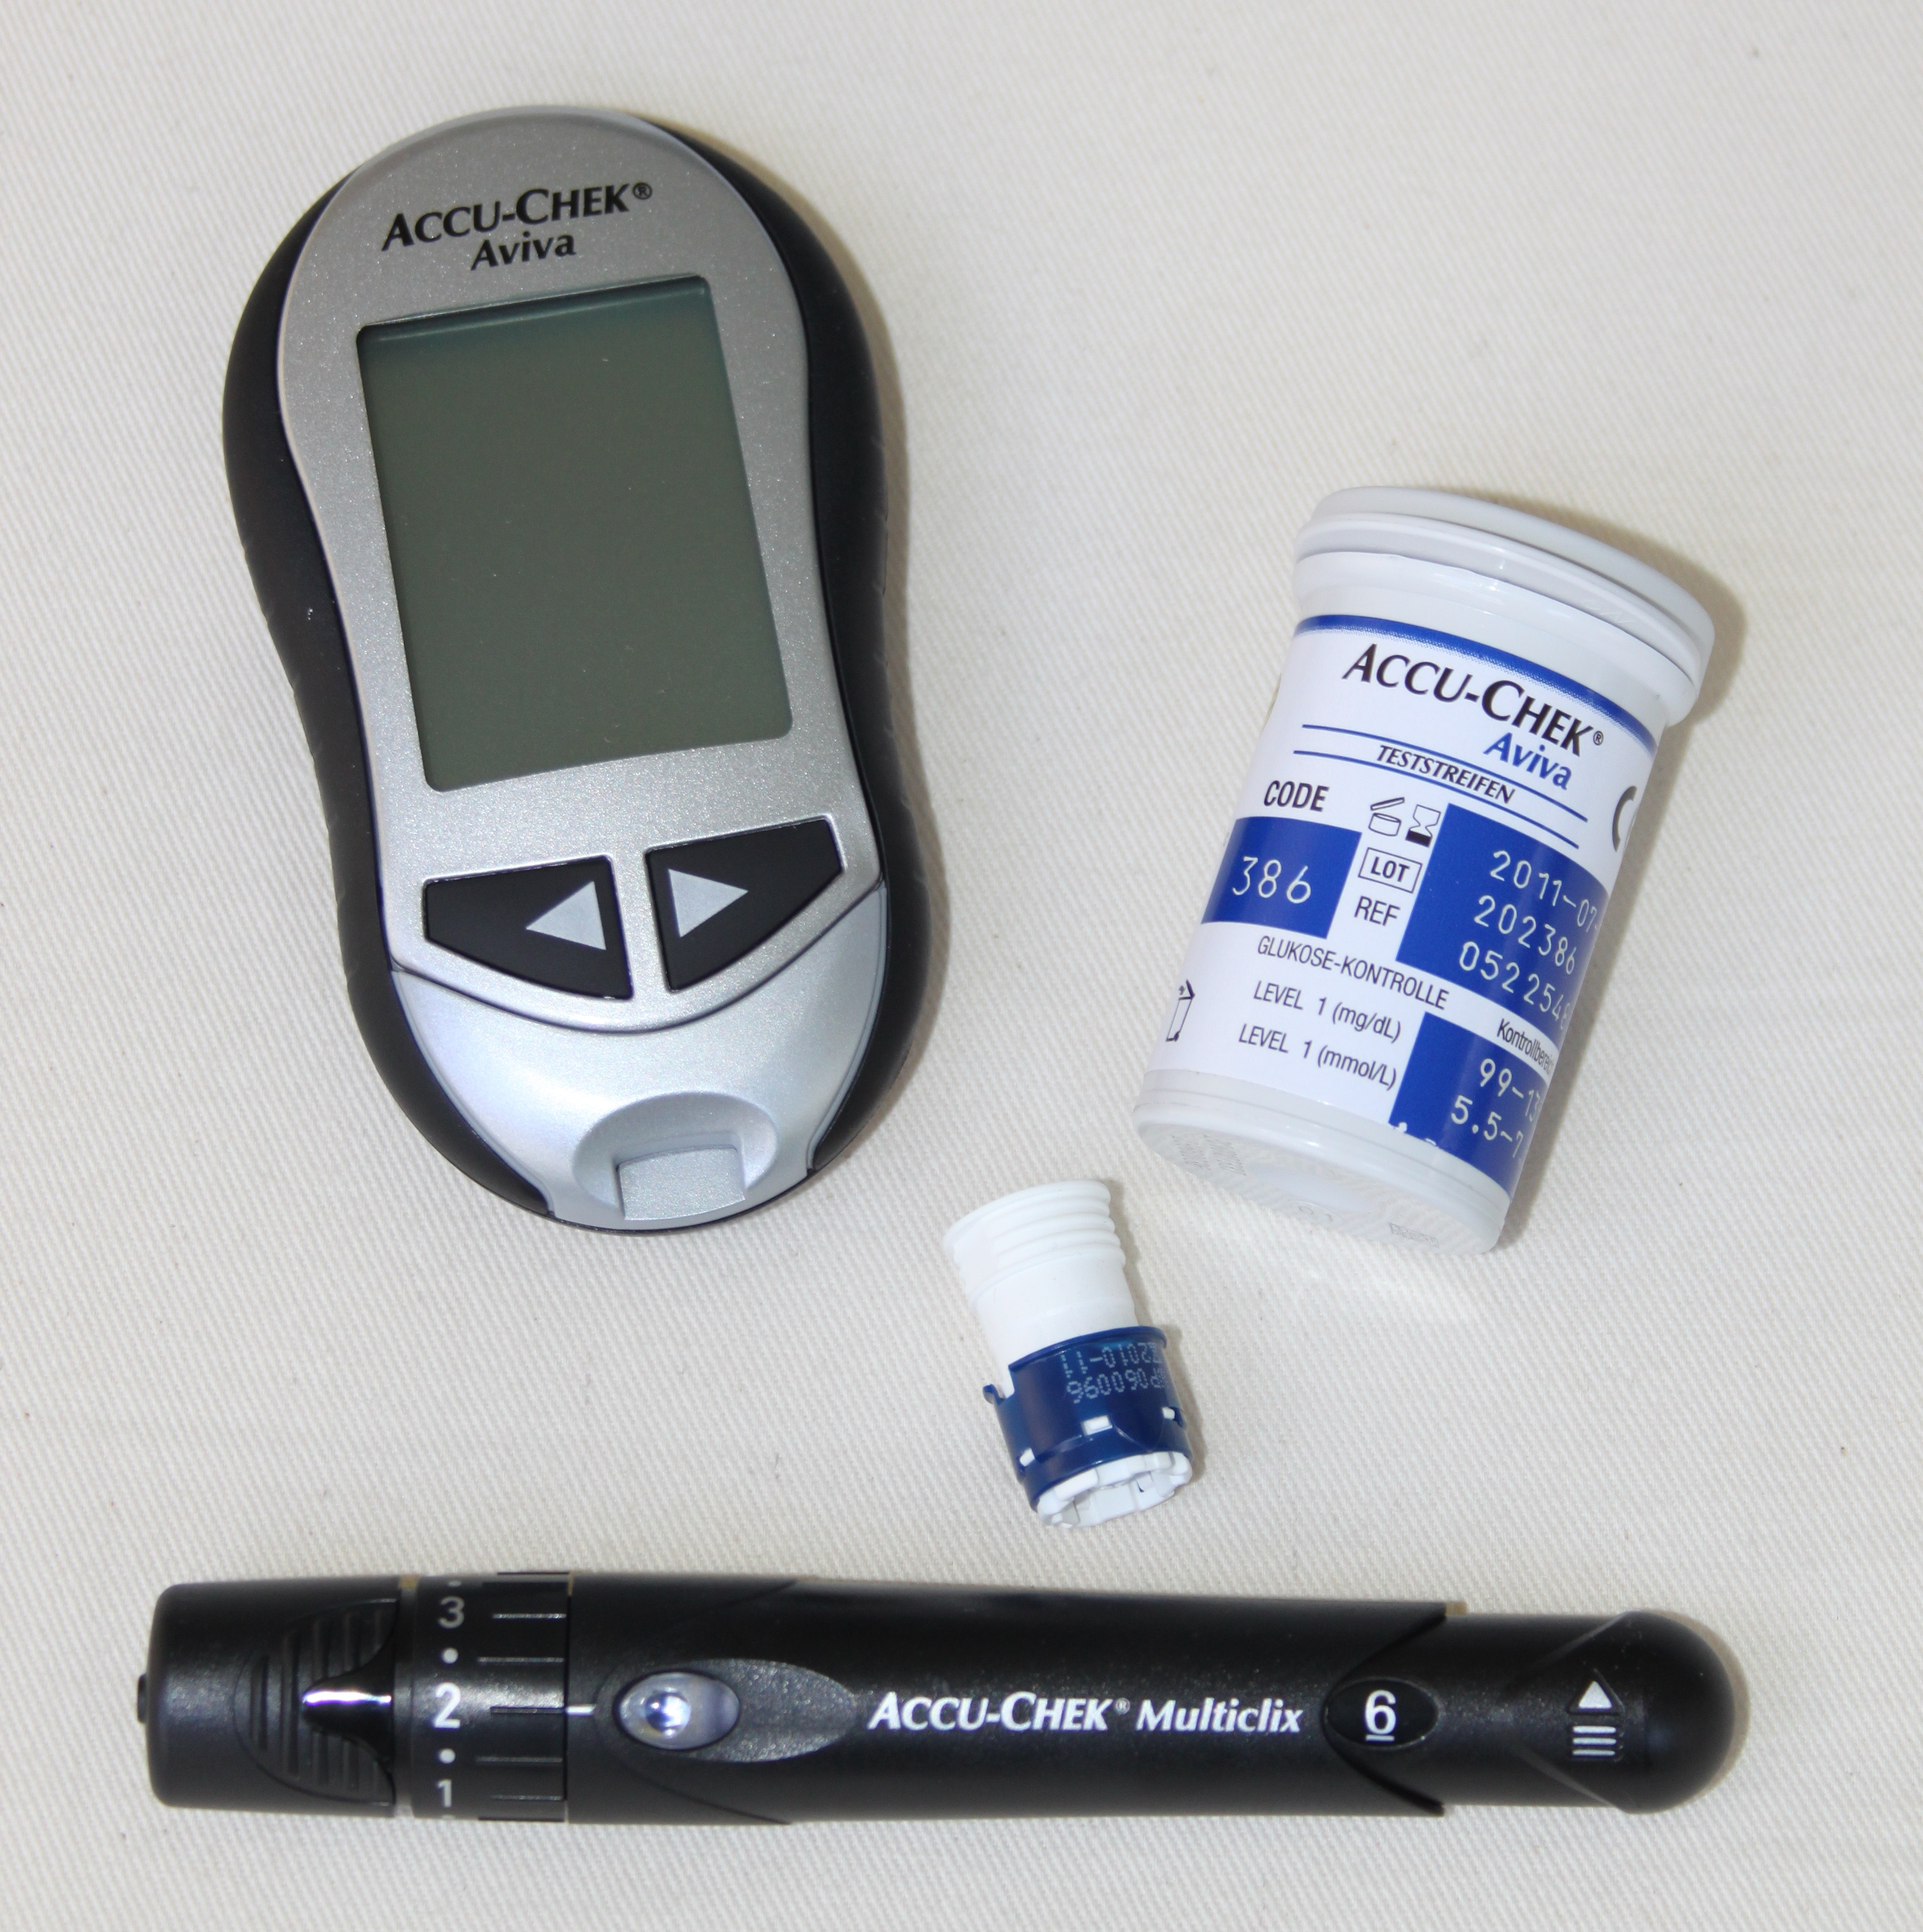
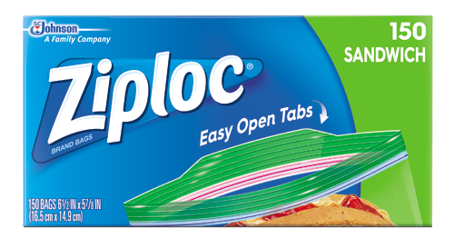



Introduction
Career
  Financial consulting
  Brand management
  Healthcare executive
  Consulting practice
Education
  BS Finance; Accounting minor
  MBA Marketing
Family
  Married 25 years
  Two daughters in college
This Photo by Unknown Author is licensed under CC BY-SA

Slide 3
Six steps to effective commercialization
Problem Identification
Does a problem exist? For whom?
Solution Design & Development
Talk to potential customers throughout design & development
Solution Evaluation
How well does the solution address the identified problem?
Pricing
Market Entry
Sales Development
How much will potential customers pay for solution?
What market segment provides biggest opportunity?
Awareness > Intrigue > Trial > Repeat Purchase > Loyalty
Market expansion

Slide 4
Problem Identification
Objective: Confirm there is a problem; understand who is having this problem, what they are doing to address it today and how significant the problem is (amount of pain)
Importance:
- Understand market landscape
- Address inherent customer inertia
Methodology:
- 1:1 interviews
- Focus groups
- Ethnographies
- Large companies may add quantitative research
Insights:
- Problem definition
- Market sizing
- Customer segments
- Competitors/substitutes
- Design input

Slide 5
Solution Design & Development
Objective: Gather interim feedback to guide design and development
Importance:
- Keeps development aligned with customer needs
- Reduces financial risk
- Understanding user interface is critical
Methodology:
- Quality Function Deployment (QFD)
- Kano Model
- etc.
Insights:
- Design input

Slide 6
Solution Evaluation
Objective: Confirm the solution you are developing solves the identified customer problem better than what they are doing to overcome it today
Importance:
- Ensure product meets customer needs prior to costly commercial launch
- Gain insights to guide commercialization efforts
Methodology:
- Quantitative research
- >85% “highly/likely” to purchase
- Compare to current
- Small companies may not be able to afford quantitative
Insights:
- Addressable market size
- Prioritized market segments for launch
- How to reach audience

Slide 7
Pricing
Objective: Determine price that maximizes revenue by understanding customer value perception (price x volume = revenue)
Importance:
- Sweet spot is tough to find
- Launch price is often difficult to change later
- Power of influencers (i.e. distributors, payors, etc.) has implications
Methodology:
- Quantitative research
- Very difficult, even for large companies
- Small companies usually do not do quantitative pricing research
- Consider influencers such as distributors and insurance
Insights:
- Price
- Revenue projections

Slide 8
Market Entry
Objective: Select market segment and target audience for commercial launch
Importance:
- Focused launch will minimize risk and cost
- Launch success drives accelerated ongoing growth
Methodology:
- Review past research for:
- Greatest solution value
- Sizable market
- Additional research may be necessary
Insights:
- Beachhead market
- Bullseye marketing target

Slide 9
Sales Development
Distribution/Sales Models
Direct sales (i.e. online)
Direct selling organization
Broker/contracted selling organizations
Wholesaler/distributor
Hybrid
Customer Journey
Awareness
Intrigue
Trial
Repeat purchase
Loyalty
Market expansion

Slide 10
Six Steps to Effective Commercialization
Problem Identification
Solution Design & Development
Solution Evaluation
Pricing
Market Entry
Sales Development

Slide 11
Key Takeaways
Leverage commercial team throughout development process
Dialogue with customers frequently
Focus launch efforts and resources to minimize risk

Slide 12
Thank you!
leveragepointadvisors.com

